Slide 1




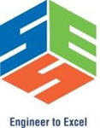
Containerized Real-Time Chat Application
Using Docker, WebSockets, and Scalable
Backend Services
Presented by: S.PadeeepKumar
Registration Number: 192425016
Course Name: CSA1014 Software Engeneering
Faculty: Dr. Geetha & Dr.K.C.Sharmili
Institution: SIMATS Engineering

Slide 2
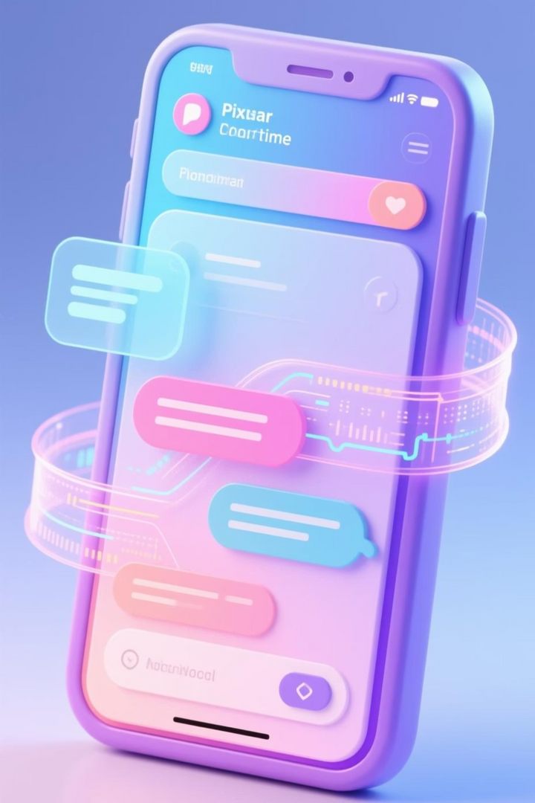
Real-Time Chat Application: A MERN Stack Capstone
This capstone project leverages the MERN stack to develop a scalable, real-time chat application, addressing the critical demand for efficient, containerized communication in modern web applications.
Real-time Messaging
1
Implementing WebSockets for instantaneous bidirectional communication.
User Authentication
2
Secured login and signup processes for user management.
Docker Containerization
3
Ensuring consistent and portable deployment across environments.
Scalable Backend
4
Designed to handle multiple concurrent users efficiently.
Notes:
2

Slide 3





Project Objectives & Milestones
Our journey focuses on building a robust, deployable system that scales seamlessly, marked by clear, measurable objectives to guide our development.
Develop MERN Chat Interface
Implement WebSockets
Containerize with Docker
For efficient bidirectional messaging.
Ensuring environmental consistency.
With JWT-secured login/signup.
Integrate Load Balancing
Evaluate Performance
To achieve high scalability.
Measuring response time and concurrency.
Notes:
3

Slide 4
Problem Statement: Addressing Modern Web App Challenges
Traditional chat applications often struggle with inherent latency, deployment complexities, and critical scalability failures under peak loads. This project directly addresses these common pitfalls.
High latency, resource-heavy
Real-time, efficient communication
Manual scaling challenges
Automated scaling via Docker
Frequent server requests
Persistent, low-overhead connections
The MERN stack, while powerful for full-stack JavaScript development, necessitates containerization (e.g., Docker) for reliable production deployment.
Notes:
4

Slide 5
Literature Review: Evolution of Real-Time Communication
Early Web
Initial reliance on HTTP polling for dynamic content, leading to inefficiencies.
AJAX (2000s)
Asynchronous JavaScript and XML improved responsiveness but still involved request/response cycles.
WebSockets (2011)
Standardized (RFC 6455) for persistent, low-latency, full-duplex communication. Technologies like Socket.io emerged.
Docker (2013)
Evolved from VMs to lightweight containers, offering portability and orchestration for complex applications (ref: Docker whitepaper).
Node.js Clustering
Leveraged for multi-core scaling, enhancing backend throughput and resilience.
Notes:
5

Slide 6
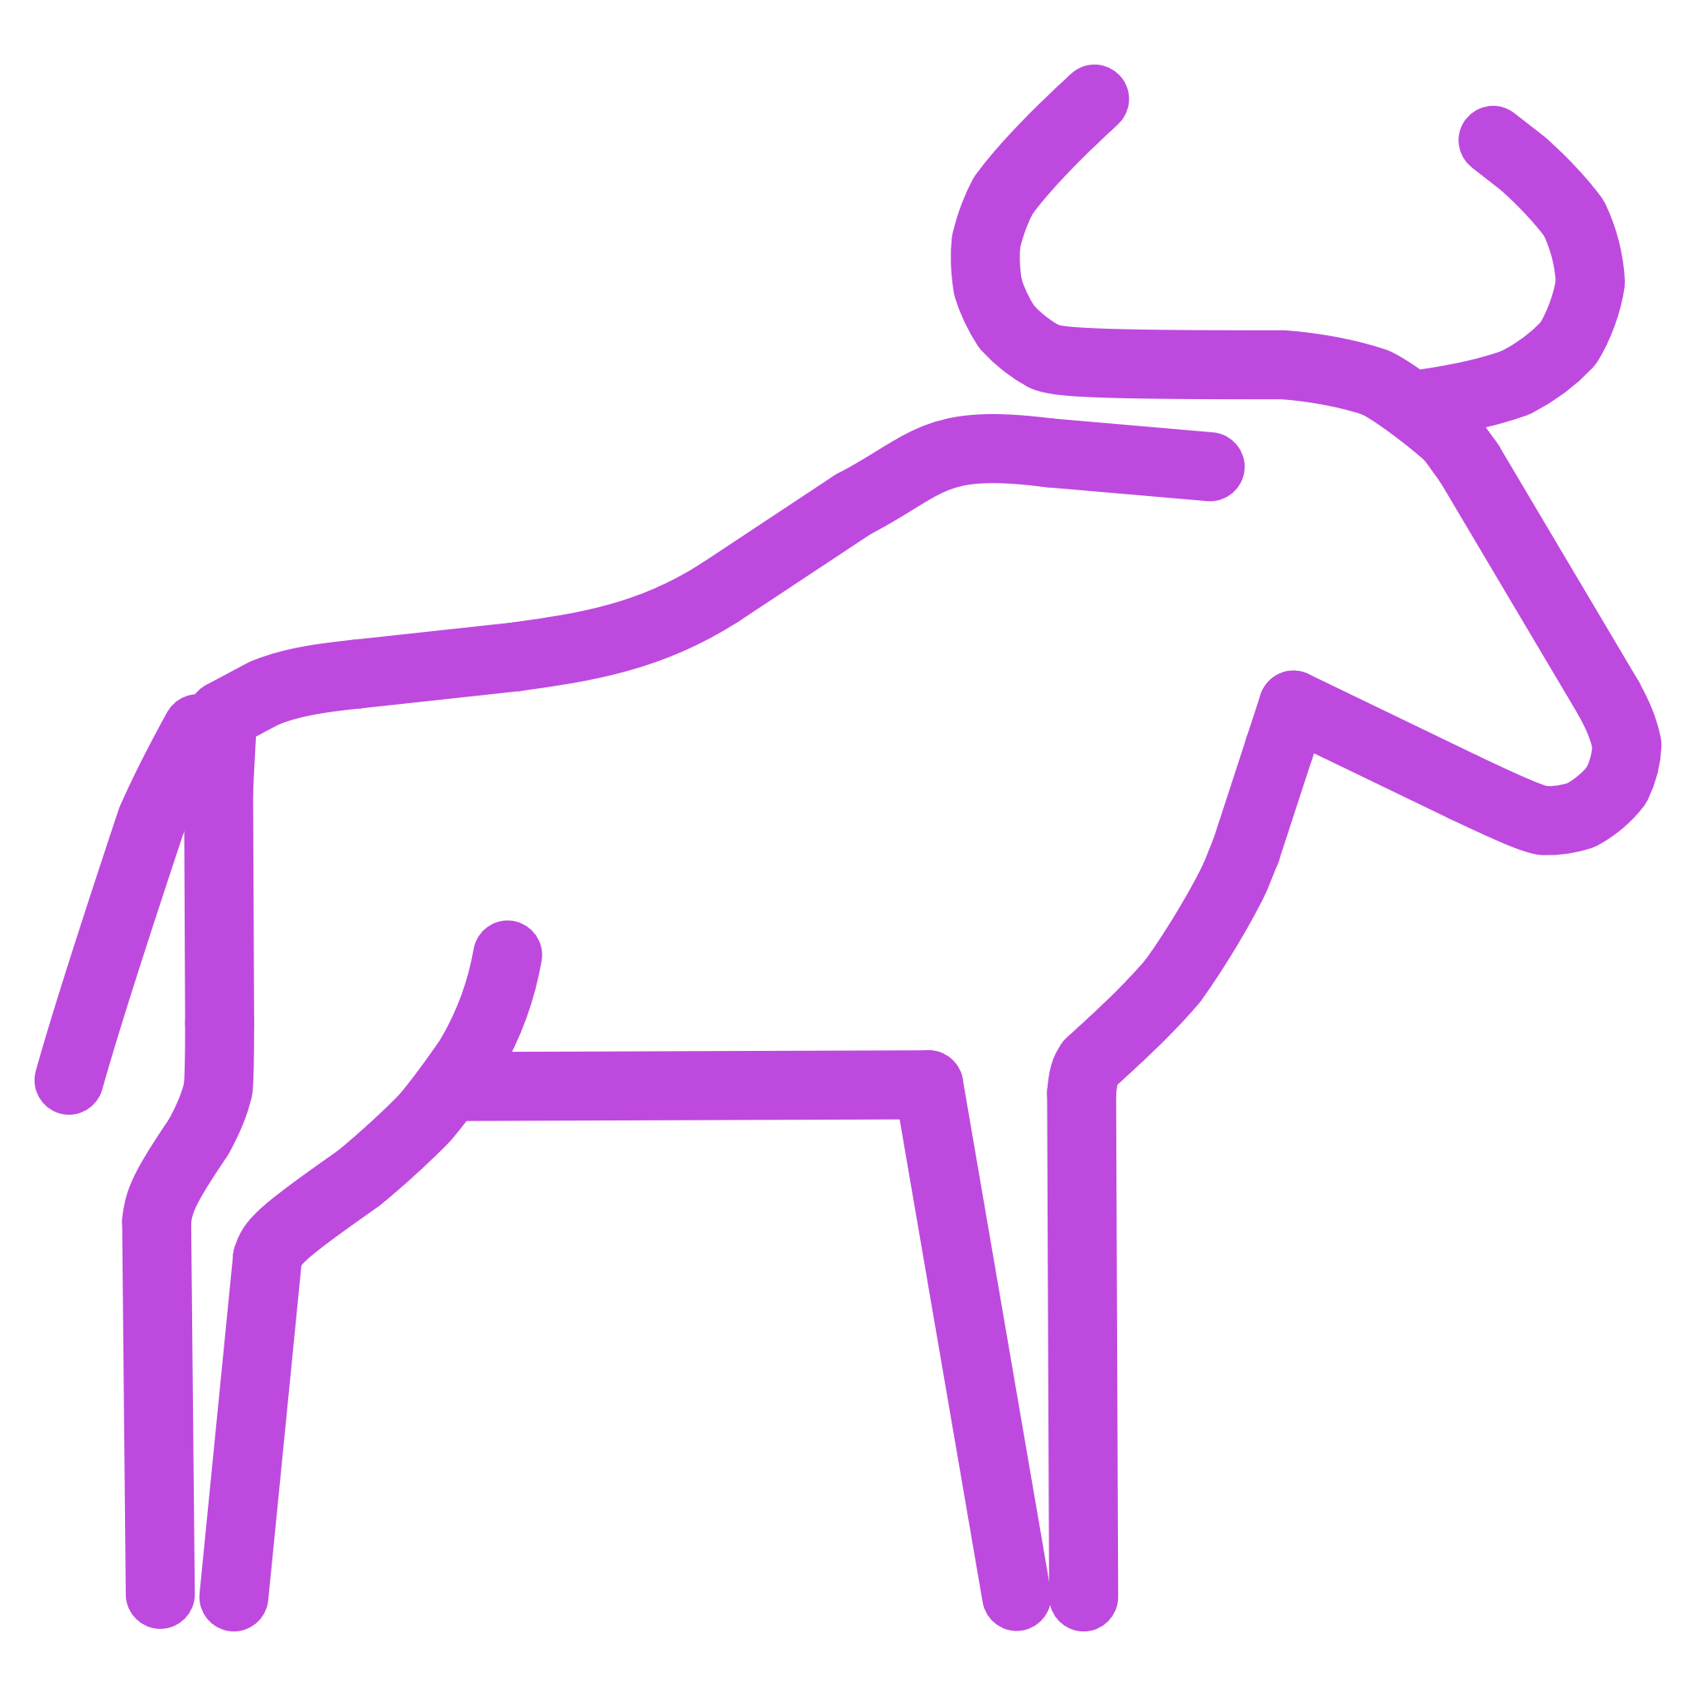
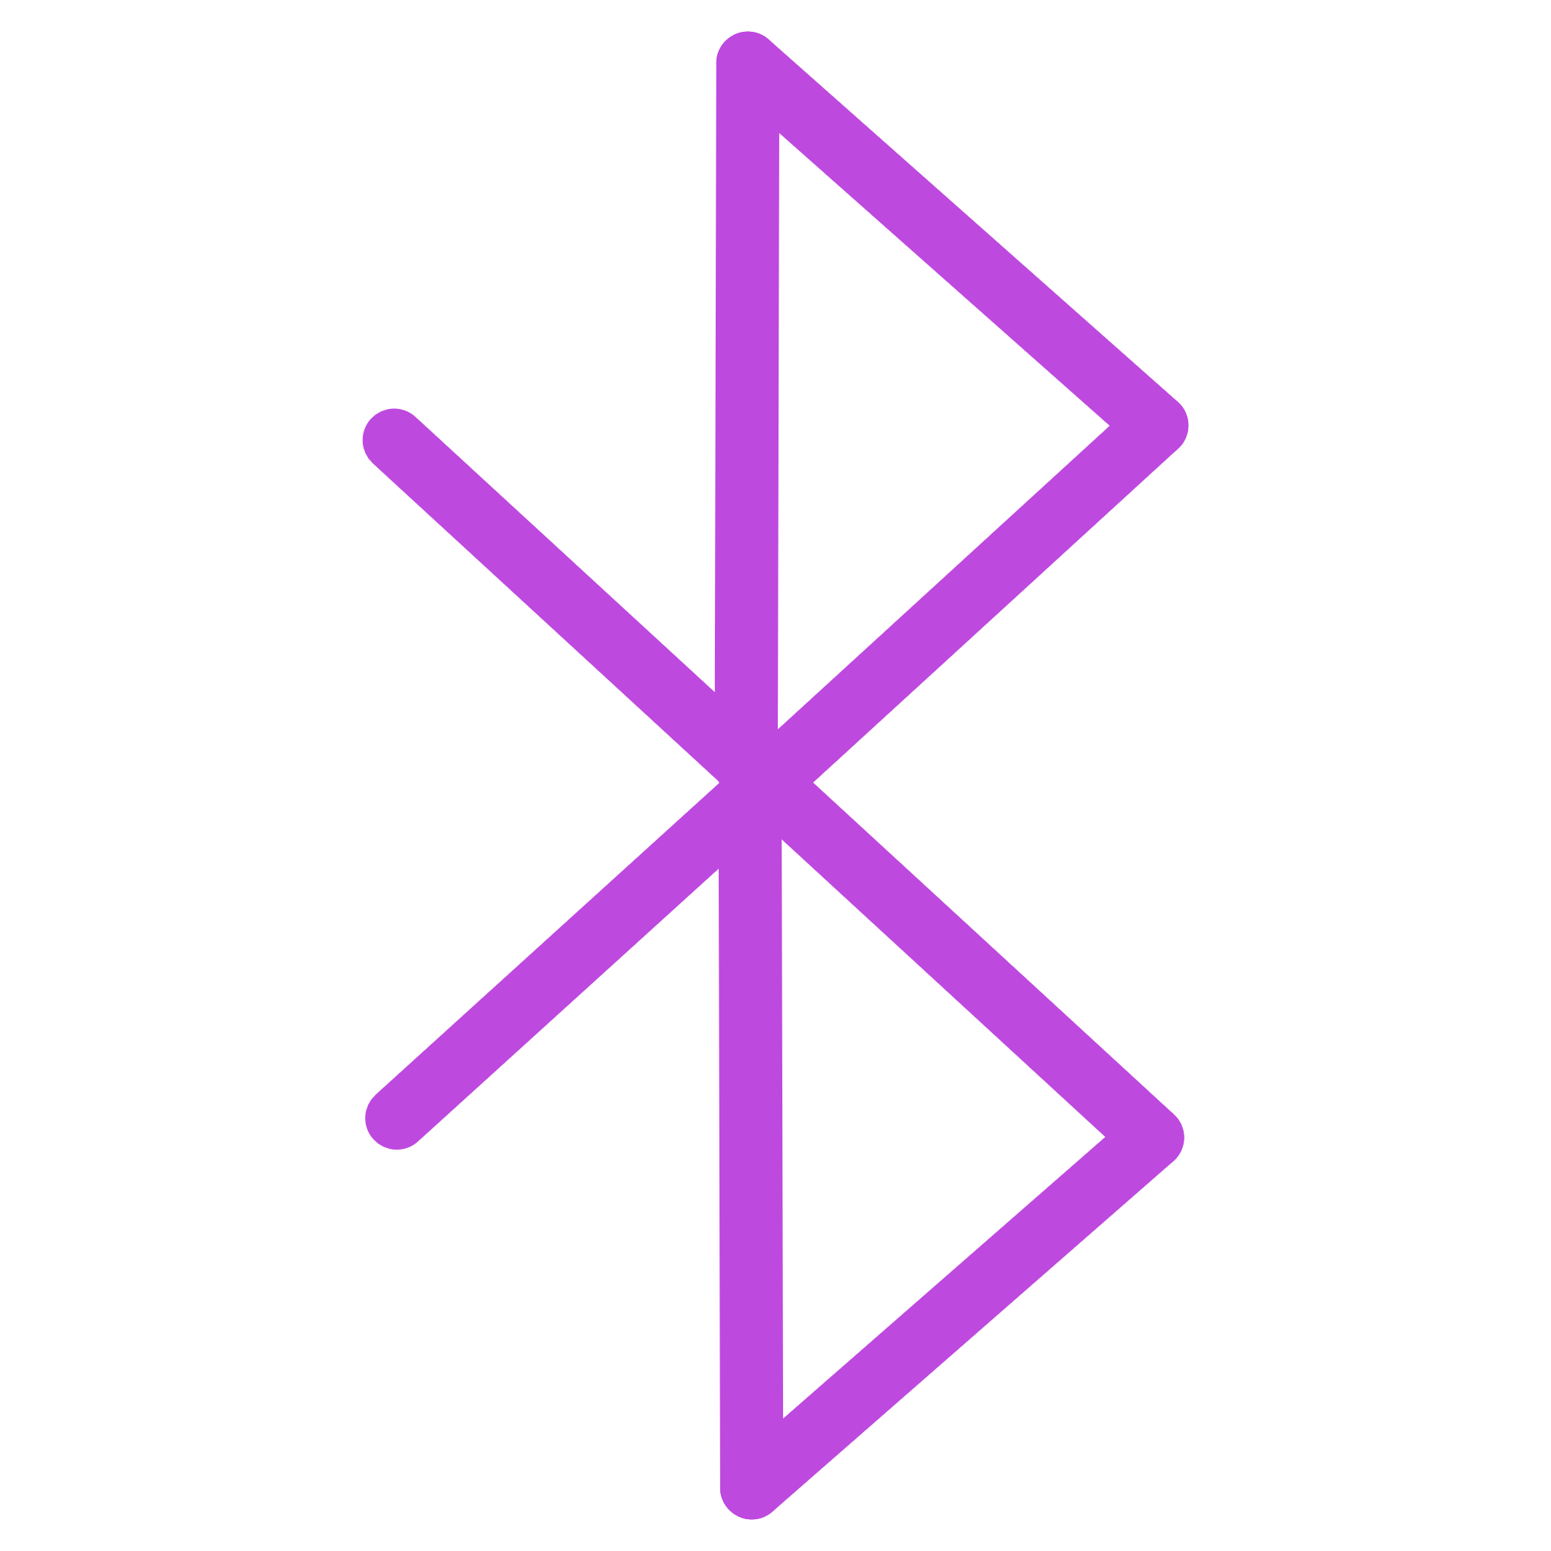
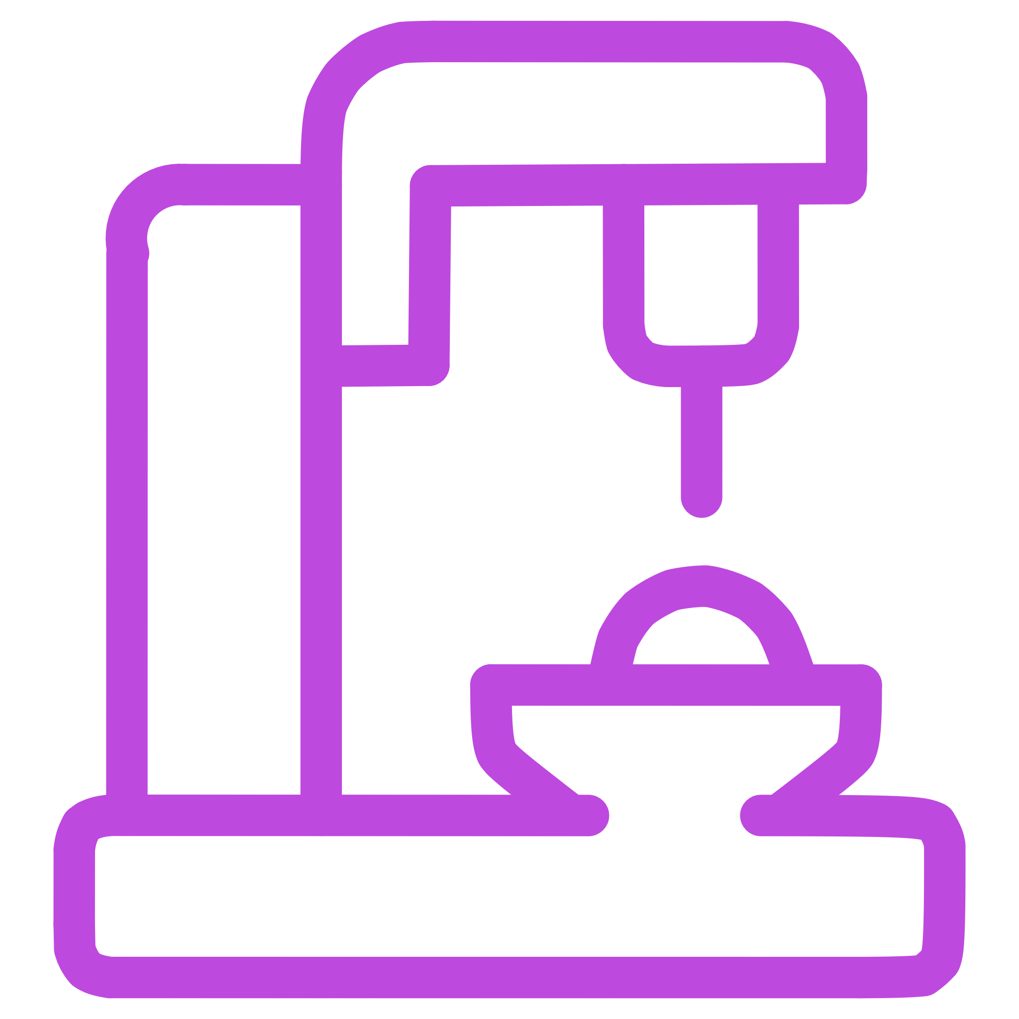

System Architecture & Technology Stack
Our system's foundation combines the versatility of the MERN stack with the robustness of containerization, ensuring a scalable and maintainable application.
Frontend: React.js
Backend: Node.js/Express.js
Database: MongoDB
Interactive chat UI, login/signup forms with Axios for API calls.
Flexible NoSQL database for user profiles and message persistence.
RESTful APIs and Socket.io for real-time messaging.
Containerization: Docker
Other Key Tech
JWT for authentication.
Multi-container setup with Docker Compose for consistent environments.
MERN enables rapid prototyping, while Docker ensures reproducibility and streamlined deployment.
Notes:
6

Slide 7
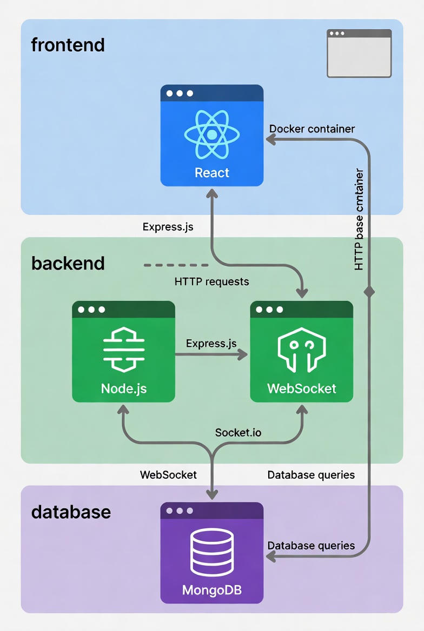

Slide 8

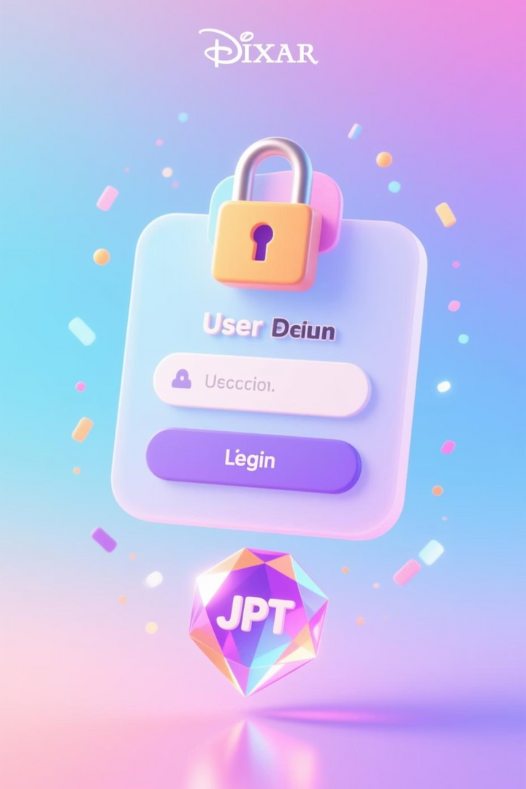
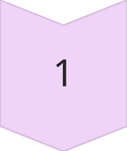
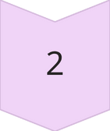
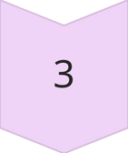
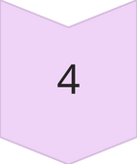
Key Feature: Secure User Authentication
Our authentication module provides secure access to the chat application, safeguarding user data and ensuring trusted communication.
Secure registration utilizing bcrypt for robust password hashing.
User Input
Seamless login with JWT (JSON Web Tokens) stored securely in localStorage.
Implementation of role-based access control for distinct user and administrative functionalities.
Validation
Password recovery feature via Nodemailer for enhanced user experience.
JWT Token
Chat Access
This structured approach ensures secure, real-time sessions from the moment a user logs in.
Notes:
8

Slide 9
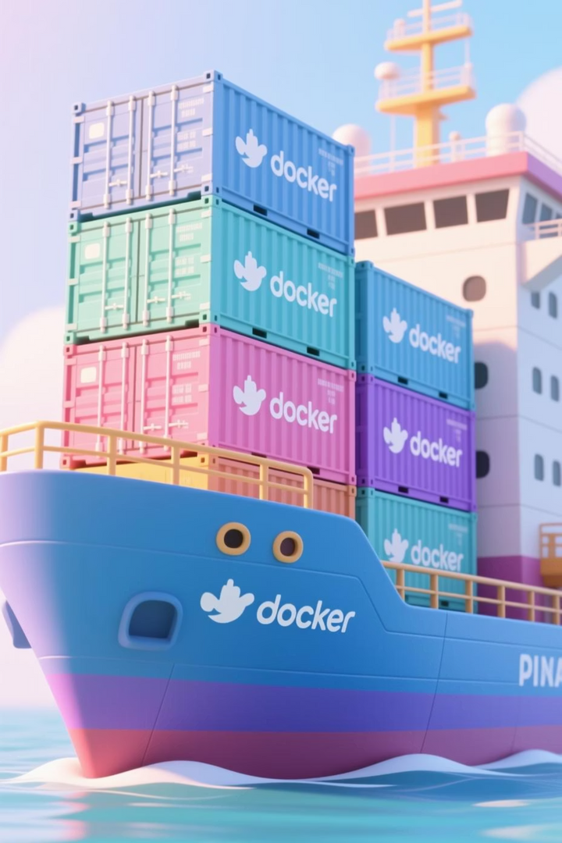
Containerization for Consistent Deployment
Docker transforms development from "local chaos" to predictable, consistent production environments, ensuring portability and scalability.
01
Dockerfile Definition
Custom Dockerfiles define build stages, dependencies (npm install), and port exposure for both frontend and backend services.
02
Docker Compose Orchestration
A docker-compose.yml file orchestrates multi-container applications (e.g., app, MongoDB, Nginx) for easy setup and management.
03
Benefits
Achieves process isolation, simplified dependency management, and enables efficient scaling with Docker Swarm.
04
Commands
Simple commands like docker build, docker run, and docker compose up streamline development and deployment workflows.
# Dockerfile snippet for Node.js app
FROM node:18-alpine
WORKDIR /app
COPY package*.json ./
RUN npm install
COPY . .
EXPOSE 5000
CMD ["npm", "start"]
Notes:
9

Slide 10
Implementation, Testing, & Challenges Overcome
Our development journey followed an agile methodology, integrating iterative testing and proactive problem-solving to deliver a robust solution.
Development Phases:
Testing & Results:
Phase 1 : Core MERN setup and authentication implementation.
Unit (Auth)
Jest
95% coverage
Phase 2: Real-time chat integration with Socket.io.
Phase 3: Dockerization and comprehensive testing.
Integration
Postman
200ms latency
Phase 4 : Cloud deployment (AWS EC2) and CI/CD via GitHub Actions.
Load
Artillery
500 users stable
Docker
Swarm
Zero downtime
Key Challenges & Solutions:
Achieved 99% uptime with iterative fixes via debugging and community resources like Stack Overflow.
WebSocket drops: Implemented automatic client-side reconnection logic.
Volume persistence: Utilized named Docker volumes for data integrity.
CORS issues: Configured robust Express.js middleware policies.
Notes:
10

Slide 11

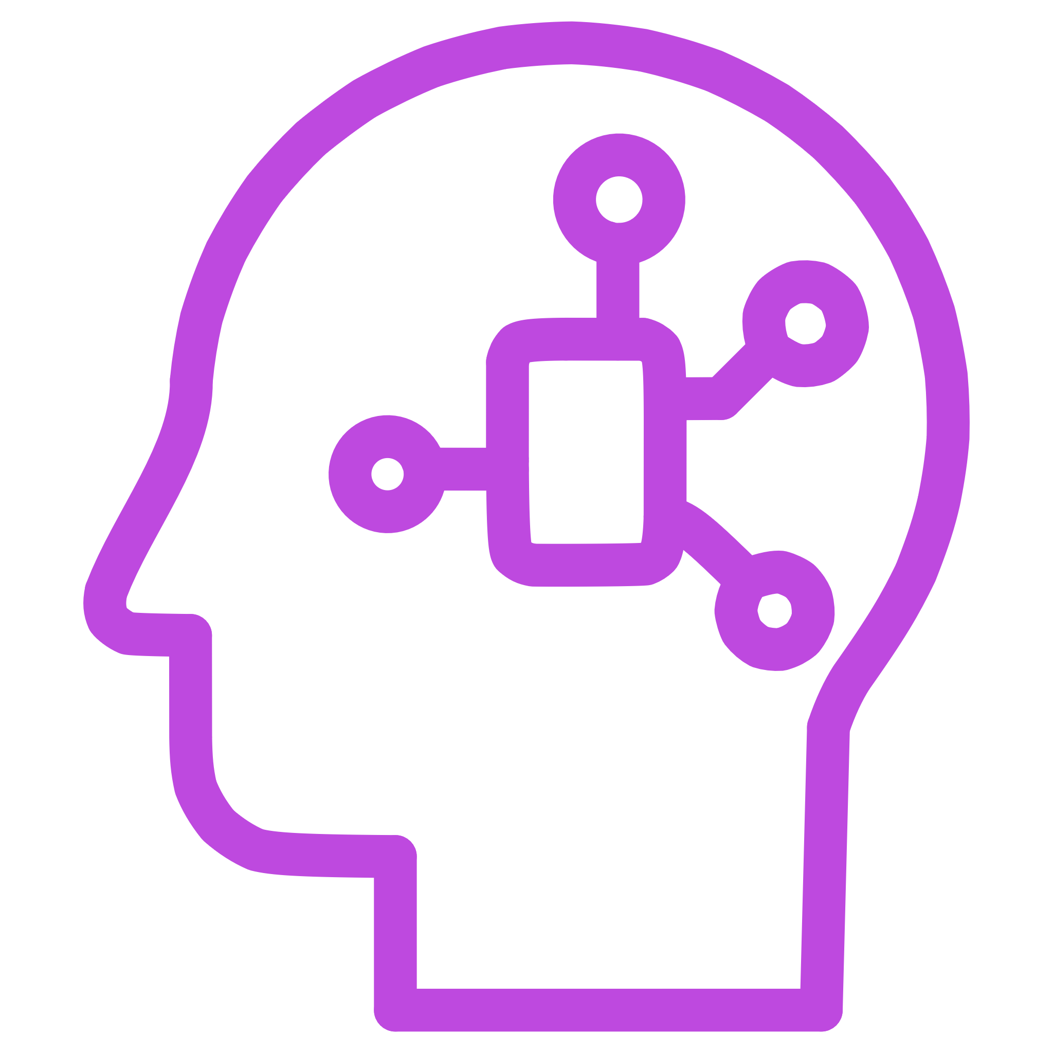
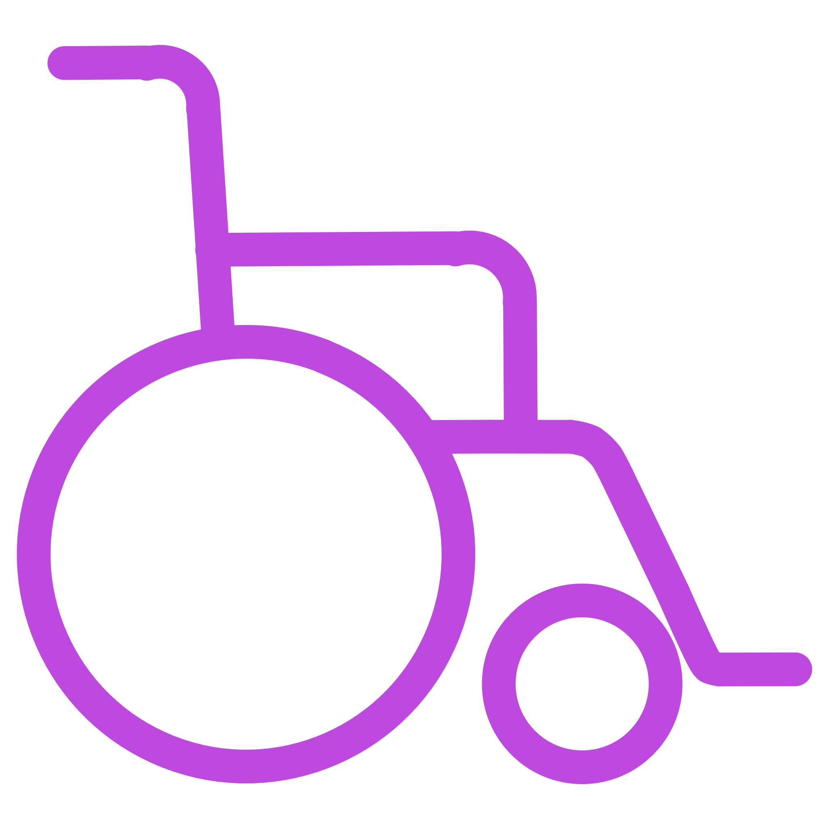
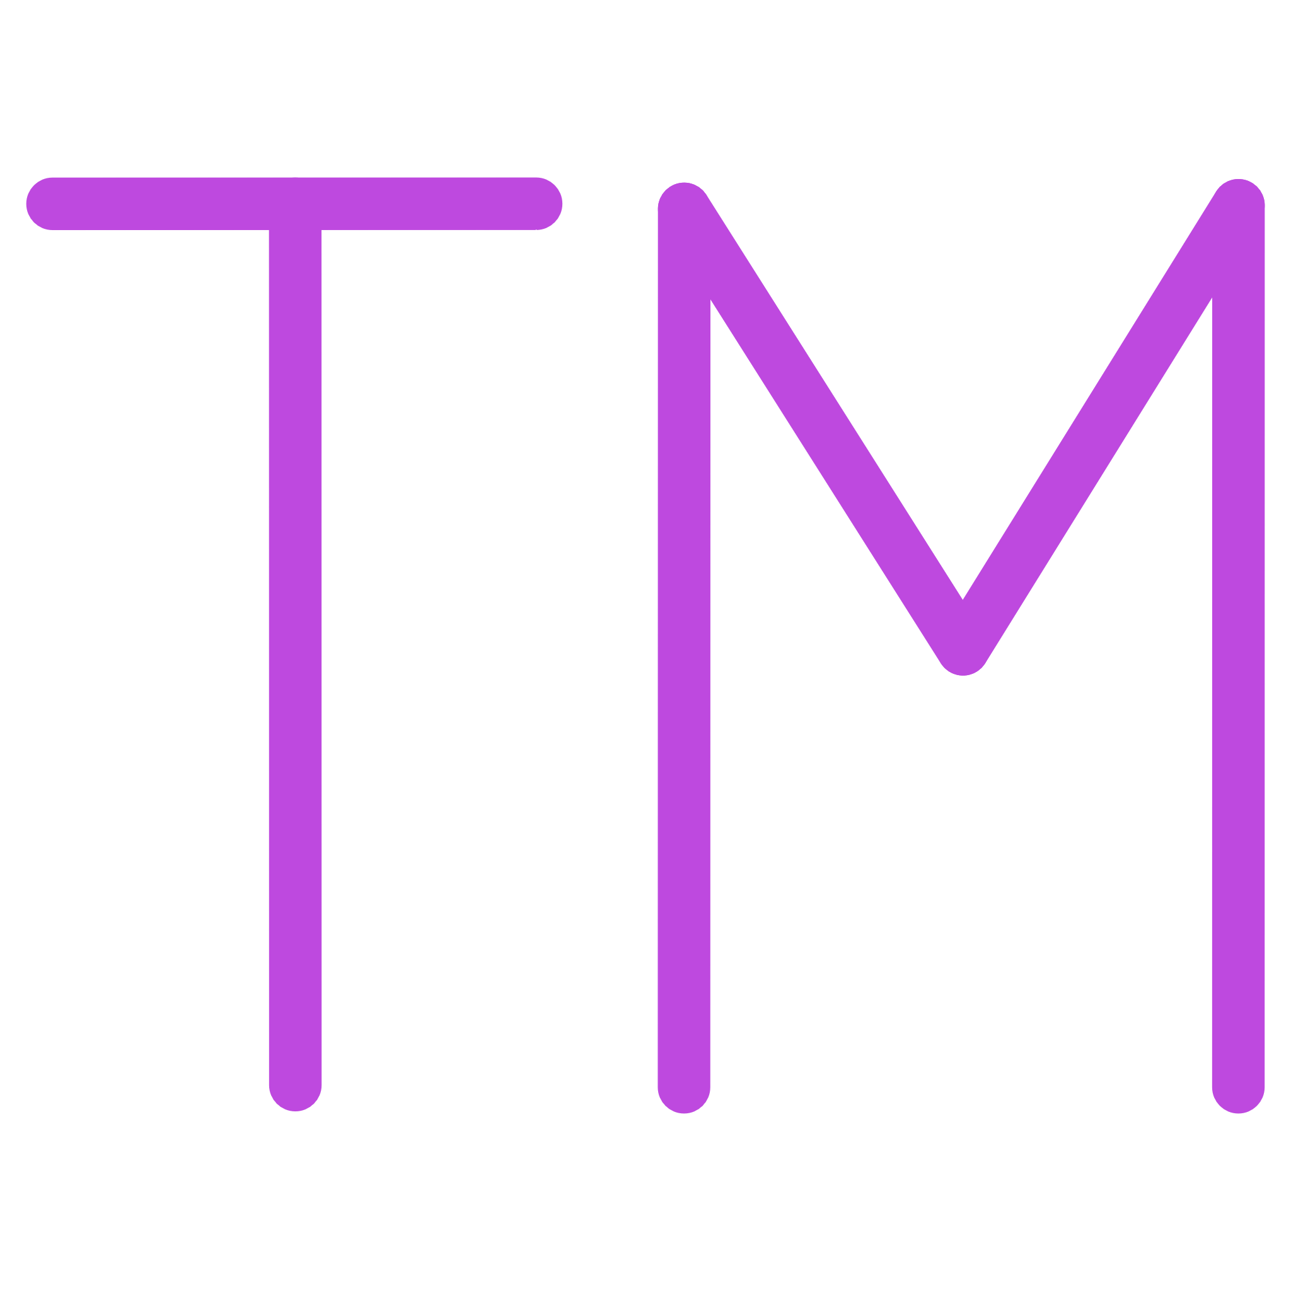

Future Work & References
WebRTC Video Calling
ML Moderation
React Native Mobile App
Integrating real-time audio/video communication directly into the chat.
Automated content moderation for a safer and more positive environment.
Extending the chat experience to native iOS and Android platforms.
Full Kubernetes Deployment
Engagement Analytics
Advanced orchestration for enterprise-grade scalability and resilience.
Tracking user activity and platform performance for continuous improvement.
From MVP to enterprise-ready, the evolution continues. We invite contributions to our open-source GitHub repository.
Key References:
Socket.io Documentation: socket.io
Docker Whitepaper: "Containerization: The Future of Application Development"
RFC 6455: The WebSocket Protocol
MongoDB Documentation: mongodb.com
freeCodeCamp MERN Stack Curriculum
Notes:
11

